Slide 1


FAKE NEWS DETECTION
- Prathamesh Mistry

Slide 2
INTRODUCTION
The authenticity of Information has become a longstanding issue affecting businesses and society, both for printed and digital media. On social networks, the reach and effects of information spread occur at such a fast pace and so amplified that distorted, inaccurate, or false information acquires a tremendous potential to cause real-world impacts, within minutes, for millions of users. Recently, several public concerns about this problem and some approaches to mitigate the problem were expressed.

Slide 3
Conceptual Background of the Domain Problem
Fake news has existed for a very long time, nearly the same amount of time as news began to circulate widely after the printing press was invented in 1439. Fake news on social media has been occurring for several years; however, there is no agreed upon definition of the term “fake news”. To better guide the future directions of fake news detection research, appropriate clarifications are necessary. Social media has proved to be a powerful source for fake news dissemination. There are some emerging patterns that can be utilized for fake news detection in social media. A review on existing fake news detection methods under various social media scenarios can provide a basic understanding on the state-of-the-art fake news detection methods.
Fake news detection on social media is still in the early age of development, and there are still many challenging issues that need further investigations. It is necessary to discuss potential research directions that can improve fake news detection and mitigation capabilities.

Slide 4
Analytical Problem Framing
The problem is of Binary Classification. We have to classify 0. The news in genuine or 1. The news is fake.
We have 20.8K news records in the dataset.
There are some missing values in the dataset , but are very less compared to the density of the dataset.
There are in total 5 features in the dataset.
create word dictionary and word cloud for further and future analytics.

Slide 5
Visualization and Data interpretation
NO MISSING DATA

Slide 6
WORDCLOUDS → GENUNINE VS FAKE AUTHOR & TITLE
GENUINE FAKE

Slide 7
WORDCLOUDS → Genuine news & Fake news
GENUINE FAKE

Slide 8
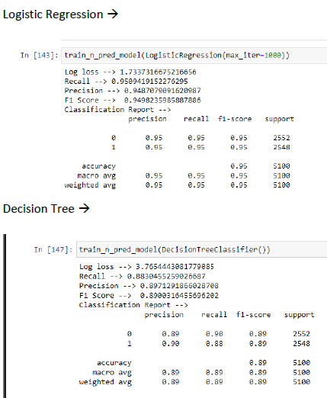
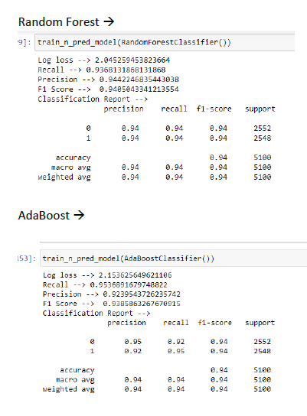
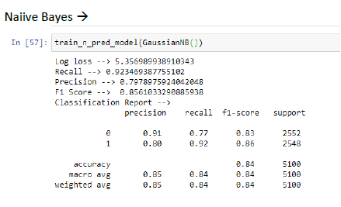
VARIOUS MODELS USED FOR VALIDATION

Slide 9
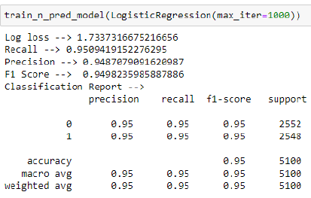
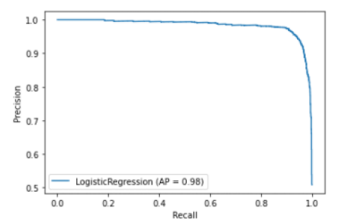
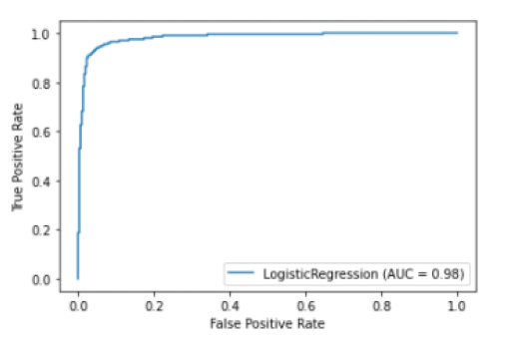
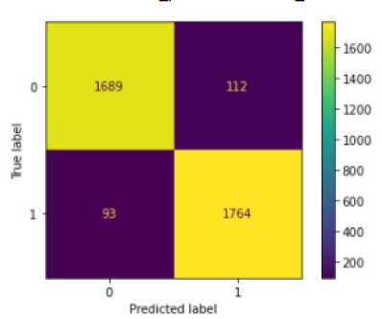
FINALIZED MODEL AFTER HYPER PARAMETER TUNING
Precision vs Recall Curve
ROC Curve
Finalized Model with Best metrics after
(Hyper parameter tuning)
Confusion
Matrix

Slide 10
KEY FINDINGS
NLP gets hard are humans are not used to typing as proper grammar as years progress.
Sweet spot should be found between whether to pick stemming or lemmatization or both.
Decision Tree gives best results when we have huge data.
The titles or Fake news are of very few words as compared to the genuine ones.
The author names for the fake news are mostly fake and unknown.
Naïve Bayes does not set a high benchmark in all the MLP problems. Sometimes Logistic Regression are more efficient as well as accurate.

Slide 11
Signing off…
THANK YOU FOR YOUR TIME AND ATTENTION
GitHub: https://github.com/gitwit-mistry
LinkedIn: www.linkedin.com/in/prathamesh-mistry-a111071b4

